Slide 1
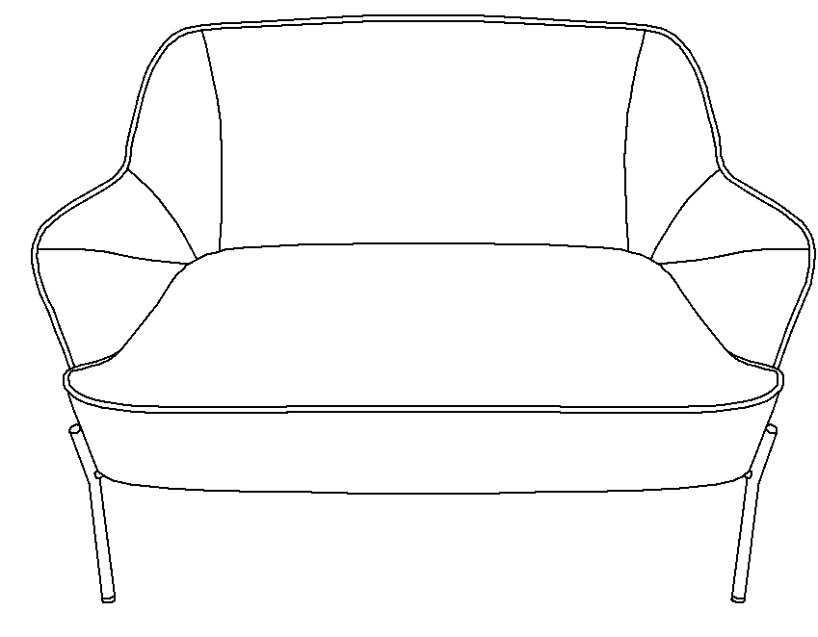
WARRANTY
We strive to offer high-quality products, and we also try our best to satisfy each and every customer that orders from us with product or service as needed. We provide 30 days warranty starting from the time you receive the item. Each customer must provide a record of their order such as the order number, or item receipt for any items that are out of the warranty period you may also still receive replacement parts by purchasing them with our company if they are available.
Are you having difficulty
with assembly? Missing parts?
Please send email with your order No
customerservice@hulalahome.com
For return, Please check the return policy with
the retailer or MarketPlace you bought from.
Appreciated your purchasing from us.
Pop up your life by our furniture piece!
ITEM NO. SFDT0127
NOTE:
This brochure contains IMPORTANT safty info. Please read and keep for future reference.

Slide 2
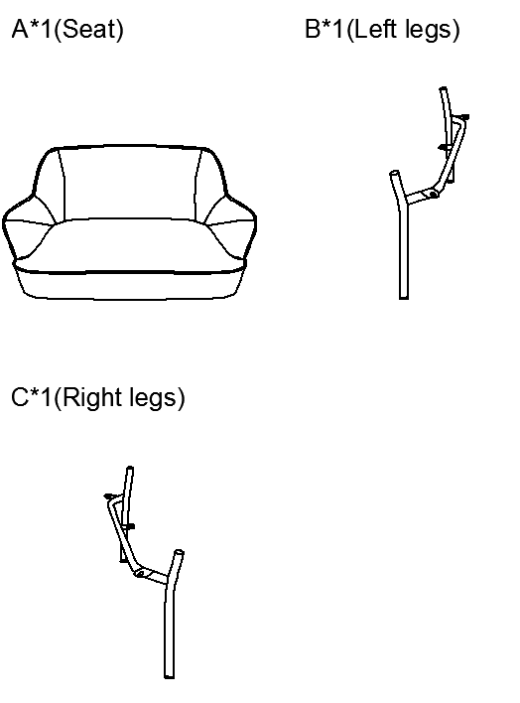
MAINTAINANCE
AND WARNING
PARTS
LIST
Keep furniture away from heat.
Do not clean furniture with harsh cleansers or polish. Do not use detergents, Solvents, abrasives, spray packs or leather cleaner. Use non-color mild soap with warm water clean spills(Mix 1:10 soap to water)
Do not place furniture under direct sunlight, material will possibly fade over time.
Do not use on site dry Cleaning machine.
Children should not climb or jump on the furniture.
Do not write on furniture without a padded barrier to protect the surface.
To obtain the longest lifespan of your outdoor products, avoid exposure to rain or snow, and direct sunshine for long time. Whenever possible cover the product and/or place under patio or awnings.
Not for commercial use, For residential use only.
Weight Limitation
Estimated Duration Of Assembly
500LBS
5-10 MINUTES

Slide 3
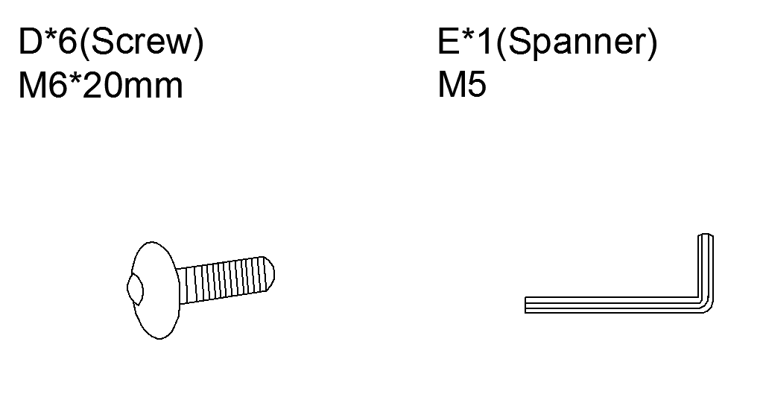
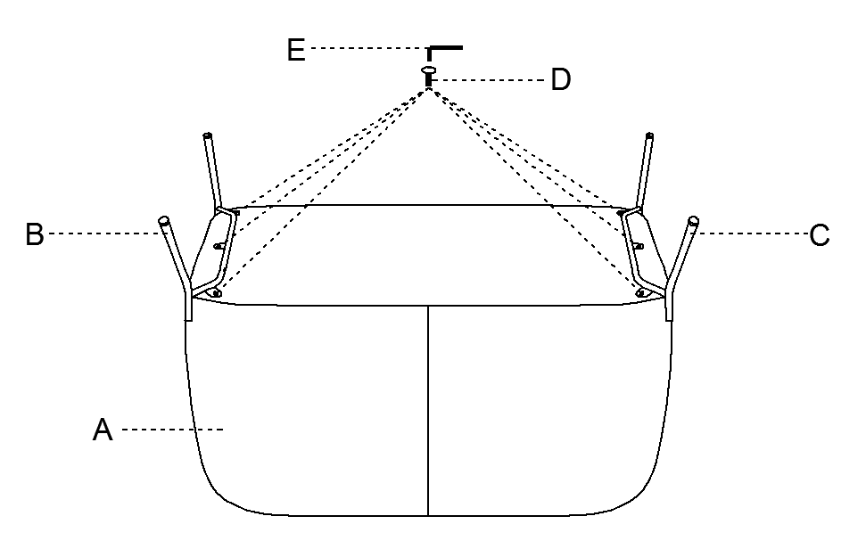
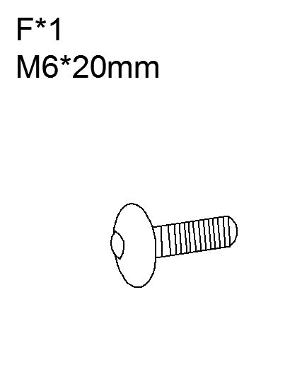
HARDWARE
LIST
ASSEMBLY
INSTRUCTIONS
SPARE
Be sure to check all packing material carefully for small parts, which may have come loose inside the carton during shipment.
STEP 1:Use bolt D allen key E to attach the leg B and C to bottom of the seat A.

Slide 4
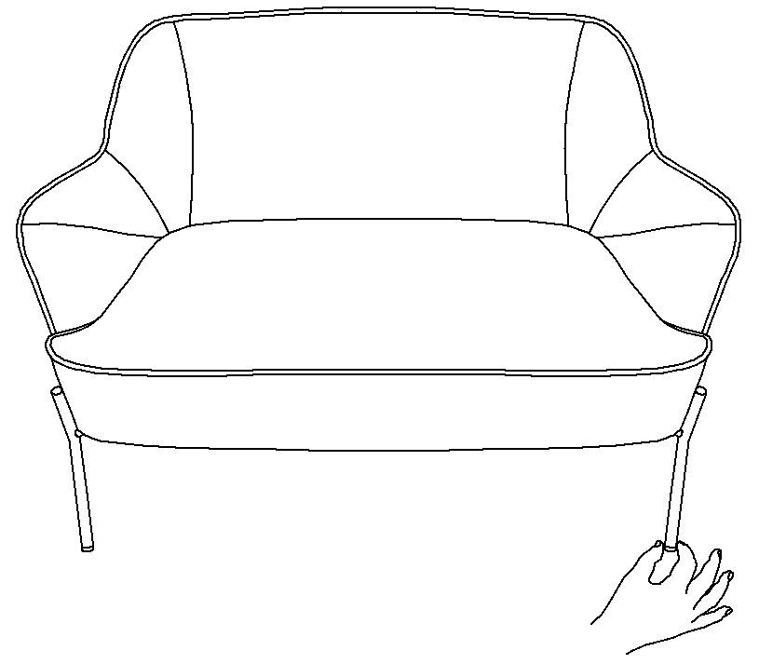
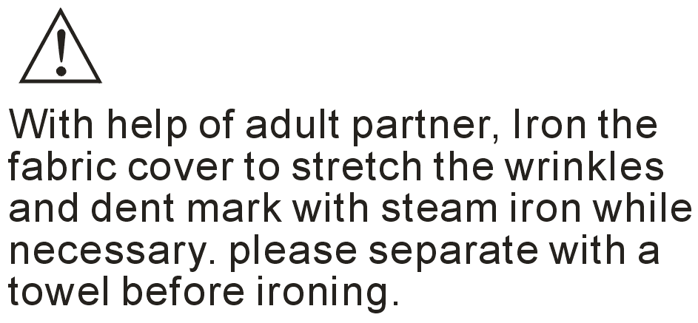
Attention: After installation,adjust the two foot nails
infront of the chair to keep the chair
balanced !
Be sure to check all packing material carefully for small parts, which may have come loose inside the carton during shipment.
STEP 2:Assembly completed

